Slide 1
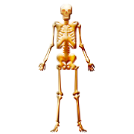
Skeletal System

Slide 2
Skeletal Functions
Provides shape and support.
Enables us to move.
Protects your internal organs.
Produces blood cells.
Stores minerals such as calcium and phosphorous.

Slide 3
Bone Formation and Growth
As a baby, most of your skeletal system is made up of cartilage.
Cartilage is broken down and replaced with calcium and phosphorous to make hard bone
Babies have over 300 bones
Adults only have 206 bones because they fuse together as you get older.
Bones are continuously being formed and reformed as they are worn down or broken.

Slide 4
Bone Structure
Bones are lightweight yet very strong.
They can absorb more force than concrete, granite, or steel.

Slide 5
Parts of a Bone
Outer membrane (periosteum)-where nerve and blood vessels enter and leave the bone
Compact bone- makes bones hard, strong, and flexible
Spongy bone- contains small spaces to make bones lightweight.
Marrow-produces blood cells and stores fat
Cartilage- flexible connective tissue at the ends of bones that help absorb shock and reduce friction.

Slide 6
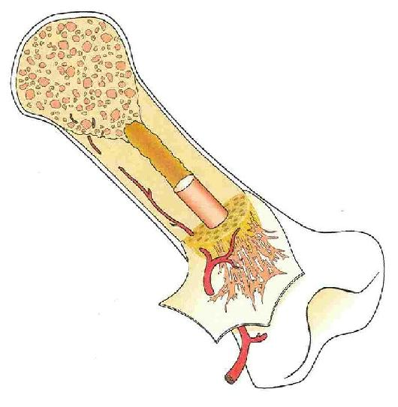
Spongy bone
marrow
compact bone
periosteum
cartilage

Slide 7
Joints
Places where two bones meet.
Held together by ligaments, which are strong bands of connective tissues
Two types
Immovable
Movable

Slide 8
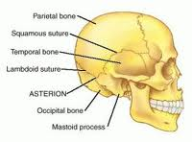
Immovable
Allows little or no movement
Ex: skull, pelvis

Slide 9
Movable Joint
Allow wide range of movement
Four types:
Hinge
Pivot
Ball and Socket
Gliding

Slide 10
Movable Joints
Hinge- back and forth motion
(ex: knee, elbow)
Pivot-one bone rotates around another
(ex: neck/head)
Gliding-one bone slides over another
(ex: wrists, ankles)
Ball and Socket- circular motion
(ex: hip, shoulder)

Slide 11
Joint animation

Slide 12
Taking care of your bones
Well balanced diet of foods rich in calcium and phosphorous (dairy, meats, whole grains, and leafy green vegetables)
Exercise
Stretching
Wear protective gear (helmets, pads)

Slide 13
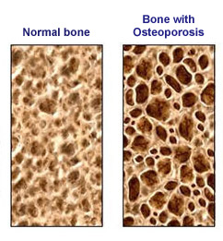
Osteoporosis
Osteoporosis-condition in which bones become brittle and weak due to mineral loss (calcium)

Slide 14
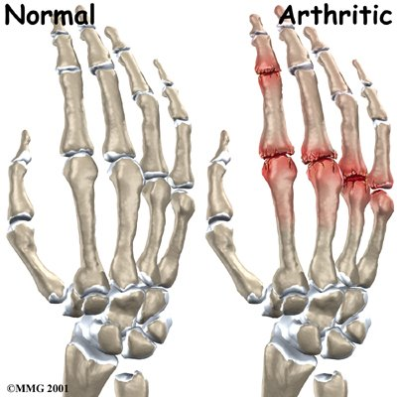
Arthritis
Means “joint inflammation”
Cartilage between joints worn away due to excessive use
Often occurs in elderly and athletes

Slide 15
Bone Injuries
Fractures
Dislocation
Sprains

Slide 16
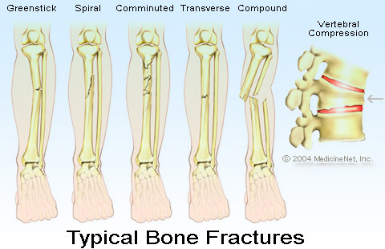

Slide 17
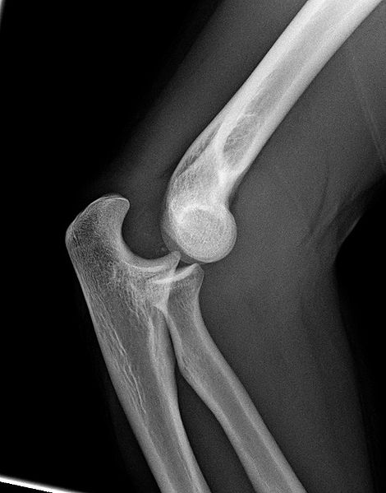
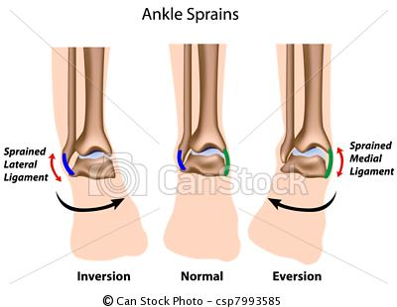

Slide 18
Diagnosing Bone Injuries
X-Rays
MRI
Bones absorb x-rays and reflect image onto photographic film
Used for bone injuries (breaks, dislocations)
Can damage cells
Cannot see soft tissue (muscle, organs)
Magnetic energy causes atoms in body to vibrate producing an image for the computer to analyze.
Used for bone and soft tissue injuries
Expensive

Slide 19
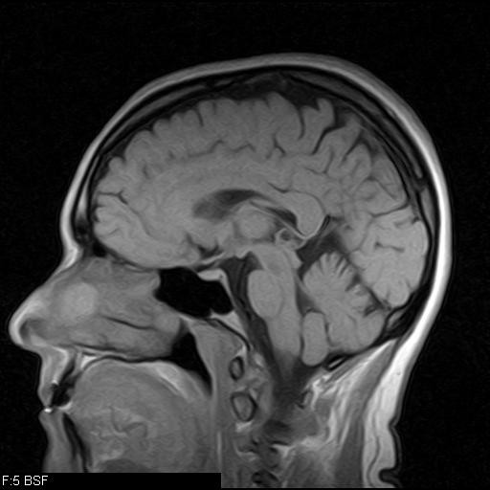
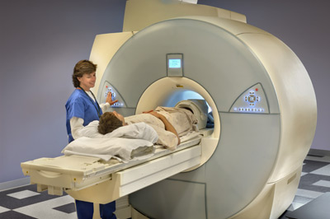

Slide 20
Treating Bone Injuries
Cast
Joint replacement
Arthroscopy

